Slide 1
Creating Risk Management Reports
Position, Mark-to-Market & Profit/Loss

Slide 2
Before you start…
You are creating three Position and MtM reports and two P/L reports. Organize your spreadsheet to make your (and your grader’s) life easy.

Slide 3
Before you start…
Tabs to include:
Summary Solution
Spot Prices
Forward Prices
Options Pricing
Other Calculations pages
Position
MtM (Mark to Market)
P/L (Profit / Loss)

Slide 4
All Report
Start with Production – it is your natural long position
Second…Fixed Price Swaps, Forwards, & Futures…because you are naturally long, these will be entered into as short positions
Options, Spreads, Spread options…last

Slide 5
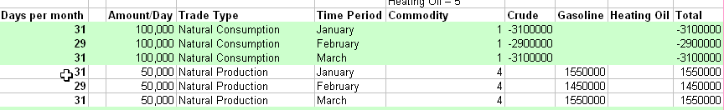
All Report
Include Summaries of each report at the bottom (and/or top) of each report as well as on the summary page
Break each position down into monthly buckets (in one quarter, you have three months of production)

Slide 6
Position Report
Production is a natural long (if this were for a consumer, your position would be short)
Assuming all long positions, your hedges will all be short positions
Fixed Price Swaps, Futures, Forwards and Spreads are always counted

Slide 7
Position Report
Options are counted only when they are “in-the-money”
Use an “if statement” based on current spot/forward price and the option strike price to determine whether the position value is a number or a zero
A maximum of only one part of a cost-less collar will ever have a value other than zero at a time on the Position Report

Slide 8
Position Report
Transportation (basis) swaps have a net zero effect on the Position Report
It is a short at the in-put location
It is a long at the out-put location
The long and short cancel each other
This makes sense because a basis swap transfers the risk from one location to another without removing the risk
This is not true for cross-commodity spreads (refinery) and time spreads (gas storage)

Slide 9
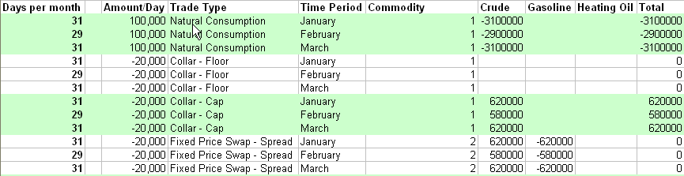
Position Report –Options & Spreads
Note: The cap portion of the collar is in the money and the floor is out of the money. If both are out of the money, both positions are zero.

Slide 10
Mark-to-Market (MtM) Report
The MtM report applies prices to all of your positions
Production and fixed price transaction values are consistent with whether they are long or short positions
Long Positions – Assets (+ $ value)
Short Positions – Liabilities (- $ value)

Slide 11
MtM Report
The MtM report applies prices to all of your positions
Options are based on whether you bought or sold the option
Holding the option – Asset (+ $ value)
Write the option – Liability (- $ value)
Note: Holding a put is a negative position but has positive value to the firm, etc.…

Slide 12
MtM Report
Spreads are based whether you are long or short the spread and whether the spread is “above water” (the current price > the spread price) or “below water” (the current price < the spread price)
Being long an “above water” spread, being short a “below water spread” is profitable
Being short an “above water” spread, being long a “below water spread” is not profitable

Slide 13
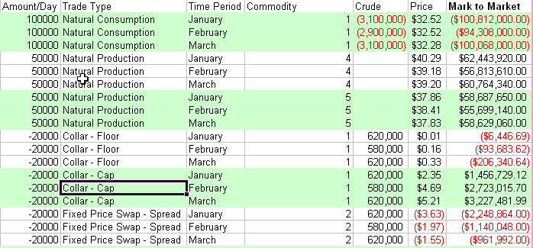
MtM Report
In the case of January, the difference between crude and gasoline is $3.63 larger than the locked-in spread. Thus, the refinery is losing money on the fixed price spread.

Slide 14
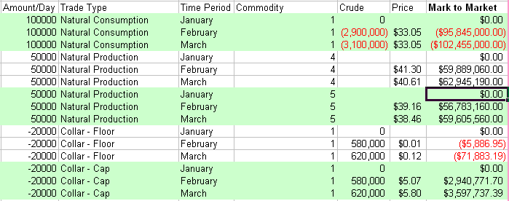
All Reports
When a month “rolls off” the books, the positions in the past have a zero quantity

Slide 15
MtM Report - Prices
Production and Fixed Price trades are “Marked-to-Market” using current prices
Production/consumption is based on the current spot or forward price
If a forward curve does not exist, you have to extrapolate a forward curve for the location
The fixed priced transactions are valued as the difference between the current price and the fixed price
Options are valued by determining the current value of the premium

Slide 16
MtM Report - Prices
Spread values are determined as the difference between the current price spread and the fixed price spread
Spread option values are determined by calculating the spread option premium

Slide 17
P/L Report
The P/L report acts as an Income Statement for the Trade floor
Profits are broken into:
Realized
Unrealized

Slide 18
P/L Report
Realized Profits
Take the average spot price of the previous month and perform the following:
Production & Consumption – (price * quantity)
Fixed Price Swap, Forward, Futures –
((price - swap price) * quantity)
Option –
In the money - ((price - strike price) * quantity)
Out of the money - $0
Options written/bought during the P/L period will have a realized gain/loss based on the premium

Slide 19
P/L Report
Unrealized Profits
Take the difference in the MtM of the most current MtM and the previous MtM
Total Profit
Unrealized
Realized

Slide 20
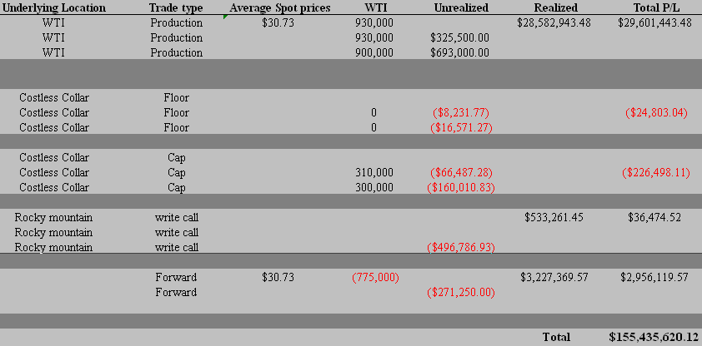
Example
Difference in forward curves
(P * Q)
Unrealized gain on costless collar
Premium from writing a call option
Unrealized gain (loss) on call option

Slide 21
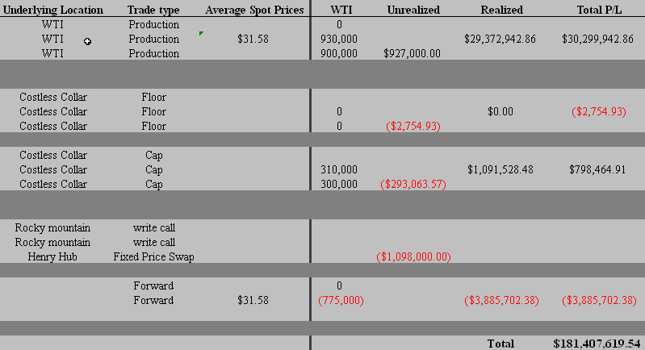
Example – One month later
Option matured out of the money
Option matured in the money

